Slide 1
A lap around Azure Integration Services
How to build integration solutions using the iPaaS Azure offering

Slide 2
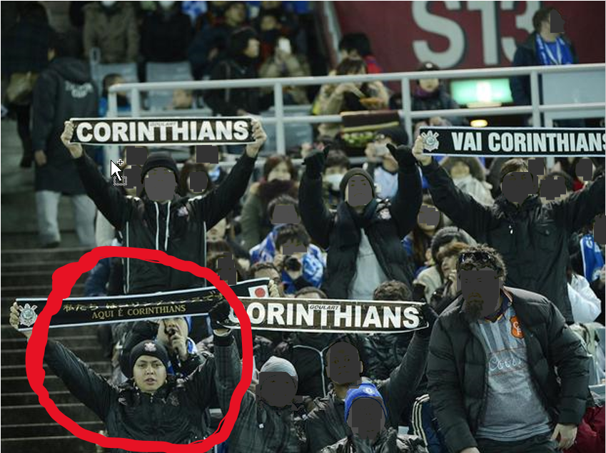
Who am I?
Recently joined ASB as Integration Specialist
Former Integration Lead Consultant for Theta
Born in Sao Paulo, Brazil
Die hard Sport Club Corinthians Paulista fan
@alessandromoura
www.alessandromoura.com.br

Slide 3
What is AIS?
APIs – How to publish and manage them
Orchestration – How to create and run integration logic
Messaging – How to communicate in a loosely coupled way
Events – How to be more efficient to learn about changes as they happen

Slide 4





Azure Integration Services Technologies
iPaaS
Serverless
Multiple personas
Azure Integration Services
Time to Market
Micro billing
Rapid development
Focus on
business logic
Reduce costs
Pay per
action
Approachable
Reduced DevOps
Low/No-code
Templates
API-centric
Event driven
scale
Abstraction
of servers

Slide 5
Demo Scenario - Current Architecture
Web App integrates with Bolinha (little ball) restaurant through a SOAP Web Service
Web App needs to integrate with another restaurant called Hocca Bar through a REST Web Service
Web App needs to integrate with another restaurant that does not have a Web Service, just SMS

Slide 6




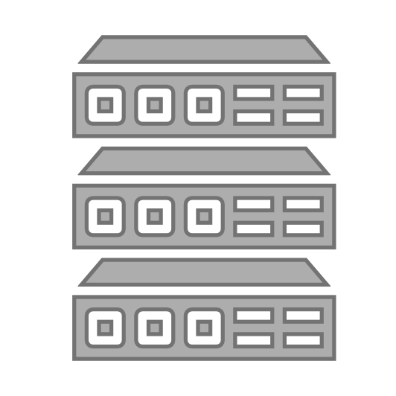


API Management
Discover
Learn
Get access
Try
Get help
SDKs and samples
1st and 3rd party apps
Abstract
Secure & protect
Manage lifecycle
Monitor & measure
Onboard developers
Monetize
Consume
Mediate
Publish
Developer portal
Gateway
Azure portal
App developers
API managers and developers
APIs hosted on and outside of Azure

Slide 7
Demo – API Management
Exposing an existing API
Import API
Canonical Model
Facilitate App Developer life

Slide 8
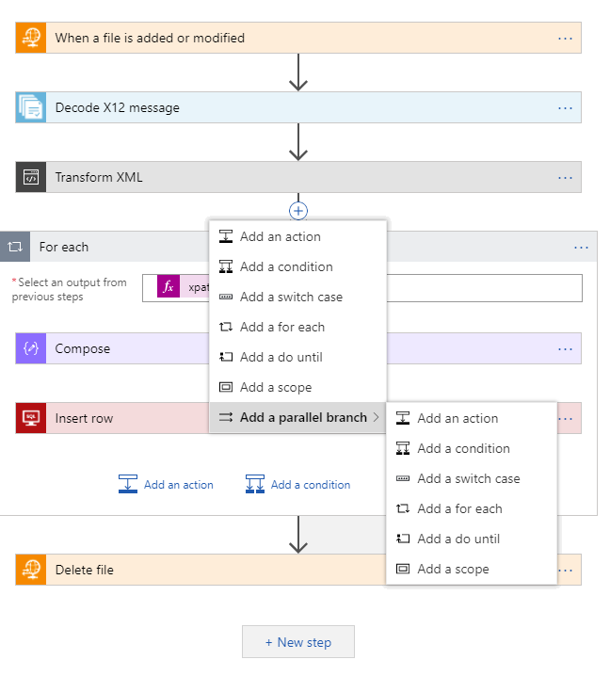
Azure Logic Apps Powerful Capabilities
Fast integration using innovative Visual Designer
Easy workflow creation with triggers and actions
More than 200 connectors to mashup applications, data and services
Built for mission critical 24x7 Enterprise Integration
Devops built-in: Create, deploy, manage and monitor

Slide 9
Demo – Logic App
Adding a orchestrator to communicate with all endpoints
Leveraging the Logic App connectors to do integration work
Web application does not have dependency on lots of components
Loosely coupled approach on the web application side

Slide 10
Service Bus - Concepts
Build reliable and elastic cloud apps with messaging
Protect your application from temporary spikes in traffic
Decouple your applications from each other
Connect your existing on-premises systems to cloud solutions
Distribute messages to multiple independent back-end systems
Scale out ordered messaging to multiple readers
Rich broker features

Slide 11
Service Bus - Features
Namespaces
Queues
Topics
Subscriptions
Message sessions
Auto-forwarding
Dead-lettering
Scheduled delivery
Message deferral
Batching
Transactions
Filtering and actions
Auto-delete on idle
Duplicate detection

Slide 12
Demo – Service Bus
Adding a publish-subscribe architecture
Brings independency to all parts
The task of one restaurant does not impact the others

Slide 13
Event Grid
Events are raised by other services
Independent individual messages
Push semantics
Filtering and routing
Pay as you go
Fan out

Slide 14
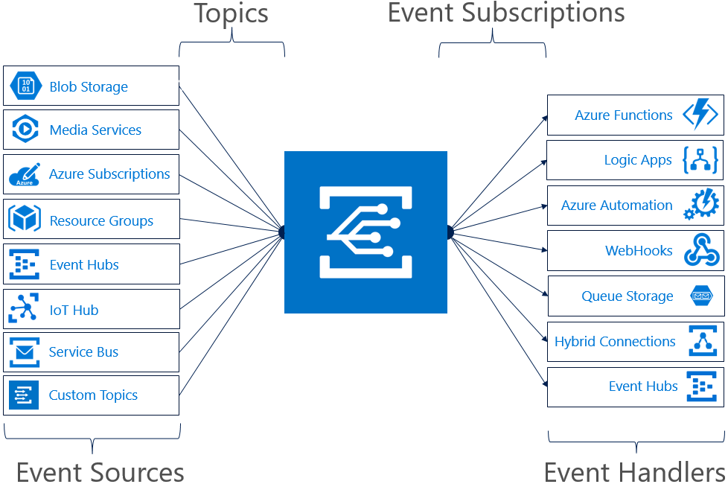
Azure Event Grid

Slide 15
Demo – Event Grid
Adding a publish-subscribe architecture
Brings independency to all parts
The task of one restaurant does not impact the others

Slide 16









Azure Functions
Events
Code
Outputs
React to timers, HTTP, or events from your favorite Azure services, with more on the way
Author functions in C#, F#, Node.JS, Java, and more
Send results to an ever-growing collection of services

Slide 17
Complementing technologies
Azure Key Vault
Azure Storage
Azure Data Factory

Slide 18
Monitoring
Log Analytics
Application Insights
Azure Monitor

Slide 19
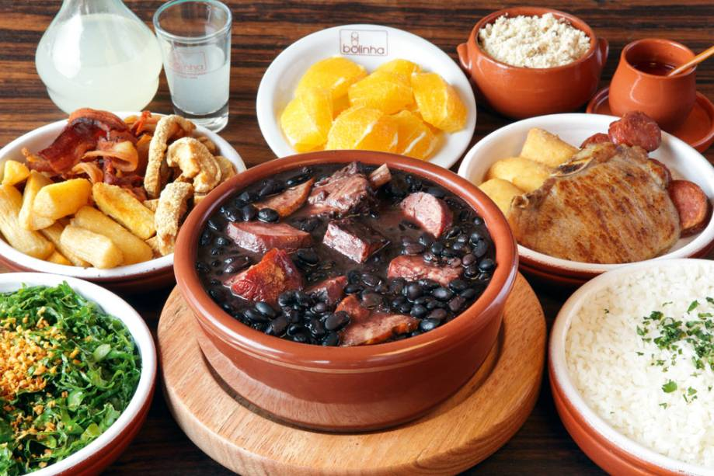

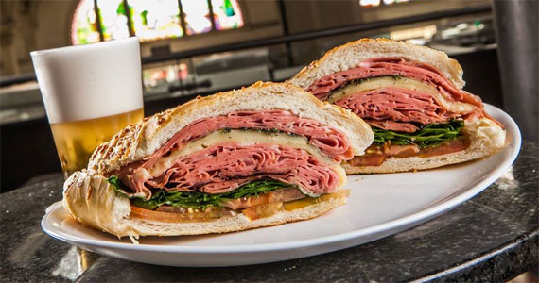



Thank You!!!
FEIJOADA
PASTEL
MORTADELA SANDWICH

